Slide 1
Unit 10
I’d like some noodles.
Section A Grammar Focus-3c
七年级(下)

Slide 2

Objectives
To learn to use would like
To learn to distinguish and use
countable and uncountable nouns
about food

Slide 3
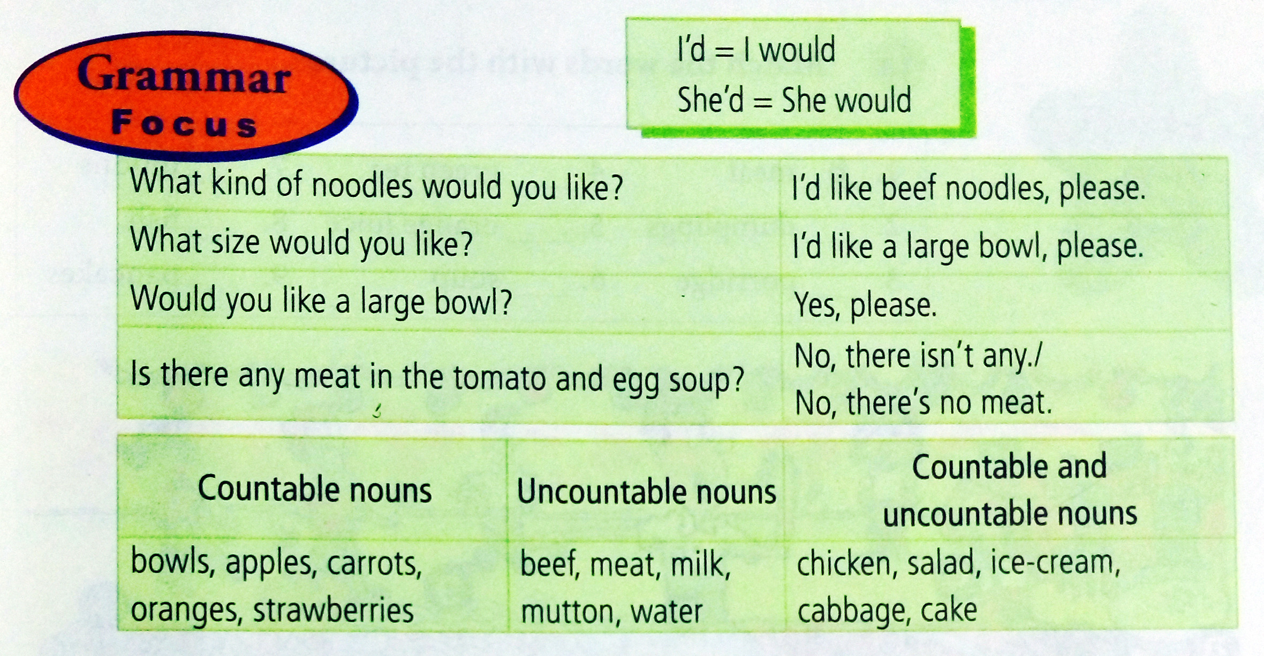

Slide 4
Grammar Focus
阅读Grammar Focus部分, 完成下列句子。
1. 你想要什么面条？
_________________________________
2. 请给我来牛肉面。________________________
3. 你想要什么碗的？_______________________
What kind of noodles would you like?
I’d like beef noodles, please.
What size would you like?

Slide 5
4. 请给我来中碗的。
___________________________
5. 你想来一个大碗吗？
___________________________
6. 好的。
___________________________
I’d like a medium bowl, please.
Would you like a large bowl?
Yes, please.

Slide 6
7. 在西红柿子鸡蛋汤里有肉吗?
_______________________________
_______________________________
不，没有。
_______________________________
_______________________________
9. I’d = ____________
10. She’d = _________
Is there any meat in the tomato and egg soup?
No, there isn’t any. /No, there’s no meat.
I would
she would

Slide 7
11. 不可数名词有：bread, milk, water,
_______________________________
12. 既是可数又是不可数的名词：salad, chicken, ice cream,
_______________________________
beef, meat, mutton
cabbage

Slide 8
探究乐园
would like 句型
一、would like 意为“想要某物”，常用句式结构：
1. 你想要点什么？
What ______ you ______?
我想要一杯茶。
____ _____ a cup of tea.
would like
I’d like

Slide 9
你想要什么面条？
What _____ of noodles _______ you like?
你想要多大号的毛衣？
What ____ of sweater ______ you like?
（以上句型为有礼貌、委婉地表达征求对方的要求）
kind would
size would

Slide 10
2. Would you like …? 你想要……吗？这 也是用来向对方有礼貌地语气委婉地 征求对方要求的句型。其答语为： Yes, please. /OK. /No, thanks.
你想要一些牛奶吗？
______ you _____ some milk?
是的，谢谢。/ 不，谢谢。
Yes, _______. / No, _______.
Would like
please thanks

Slide 11
【拓展】Would you like to do sth.? 你愿意做某事吗？
用来有礼貌地向对方提出建议或邀请的句型。答语常为“Yes, I’d like to.” “Sorry, …”
你愿意和我们一起去划船吗？
______ you ____ to ____ boating with us?
Would like go

Slide 12
二、可数名词与不可数名词
可数名词：可数名词有单数、复数之 分。其复数形式一般要加-s或-es。 如： hat — _________;
tomato — __________
2. 不可数名词没有复数形式，只有单数 形式。如：
some ______ (米饭)；
a lot of _____ (牛肉)
hats
tomatoes
rice
beef

Slide 13
(1) 不可数名词表示数量的多少时，必须与表示数量的名词连用，即“数词 + 表示数量的名词（可数名词）+ of + 不可数名词”。如：
两玻璃杯果汁
_____ ________ of juice
三碗米饭
_______ ______ of rice
two glasses
three bowls

Slide 14
(2) 不可数名词做主语时，谓语动词只能用 单数形式。例如：
在碗里有一些羊肉汤。
There ___ ______ mutton soup in the bowl.
【拓展】如果不可数名词前有复数名词短 语修饰时，谓语动词须用复数形式。 如： 房间里有两袋子大米。
______ ____ two bags of rice in the room.
is some
There are

Slide 15
用 a, an或 some填空。
Practice
a
1. _______ potato
_______ beef
3. ________ milk
4. ________ strawberry
5. ________ chicken
6. ________ egg
7. ________ mutton
8. ________ apple
9. ________ tomato
10. ______ noodles
some
some
a
some
an
some
an
a
some

Slide 16
写出下列可数名词的复数形式
1. dumpling __________ apple_______
2. box ______ watch _______
3. leaf _____ thief _______
4. country _________
strawberry ____________
5. policeman __________ woman _______
6. potato ________ tomato _________
dumplings
apples
boxes
watches
leaves
thieves
countries
strawberries
policemen
women
potatoes
tomatoes

Slide 17
Pairwork
3a
Complete the conversation below.
May I have your order? ___
2. What kind of noodles would you like?
3. We have beef, chicken, mutton, cabbage, potato, tomato … ___
4. Yes, there are some carrots. ____
5. Sure. What size would you like? ___
6. We have large, medium and small bowls.

Slide 18
a. What kind of noodles do you have?
b. Oh, a medium bowl, please.
c. OK, I’d like the mutton noodles then.
d. I’d like some noodles, please.
e. What sizes do you have?
f. Are there any vegetables in the mutton noodles?

Slide 19
Check the answers.
d
May I have your order? ___
2. What kind of noodles would you like? ___
3. We have beef, chicken, mutton, cabbage, potato, tomato … _____
4. Yes, there are some carrots. ____
5. Sure. What size would you like? ___
6. We have large, medium and small bowls. ____
a
f
c
e
b

Slide 20
Writing
3b
Write questions and answers using the words in brackets.
1. What kind of noodles would you like? (kind)_____________________________ (chicken / beef / tomatoes)
2. _____________________________(size)
___________________________(medium)
3. ____________(any/cabbage/beef noodles)
___________________________(no)

Slide 21
Check the answers.
1. What kind of noodles would you like? (kind)
____________________________________
__________ (chicken/beef/tomatoes)
2. _________________________(size)
______________________________(medium)
3. ____________________________________
(any/cabbage/beef noodles)
____________________________ (no)
I’d like the chicken/beef noodles with tomatoes.
What size would you like?
I’d like a medium bowl of noodles.
Are there any cabbages in the beef noodles?
No, there aren’t any cabbages.

Slide 22
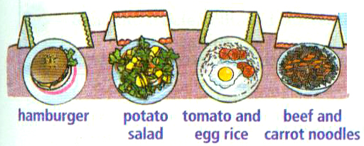
Group Work
3c
Work in small groups. Who would like the food below? Write their names on the cards above the food.

Slide 23
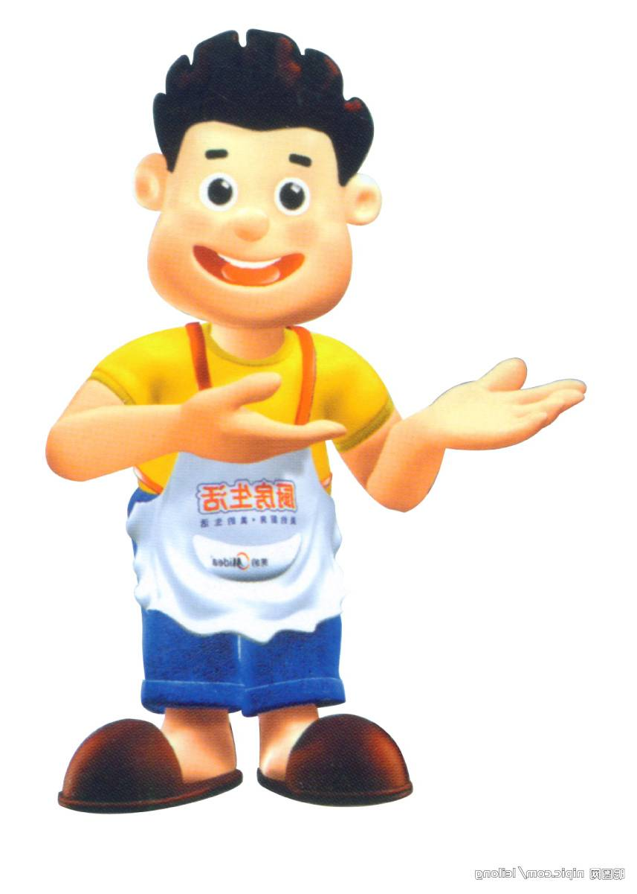
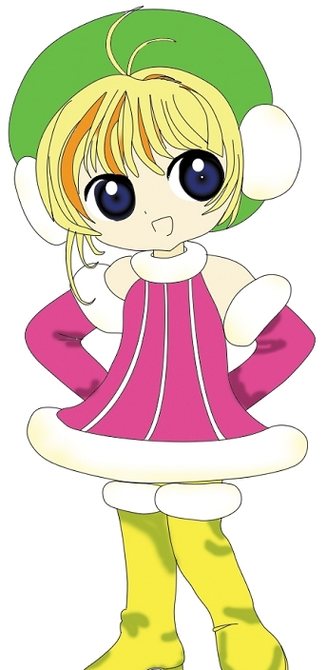
Ask and answer
Anna, what would you like to eat?
I’d like beef noodles with carrots.

Slide 24
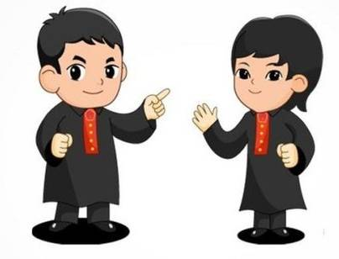
Grace, what would you like to eat?
I’d like tomato and egg rice.

Slide 25
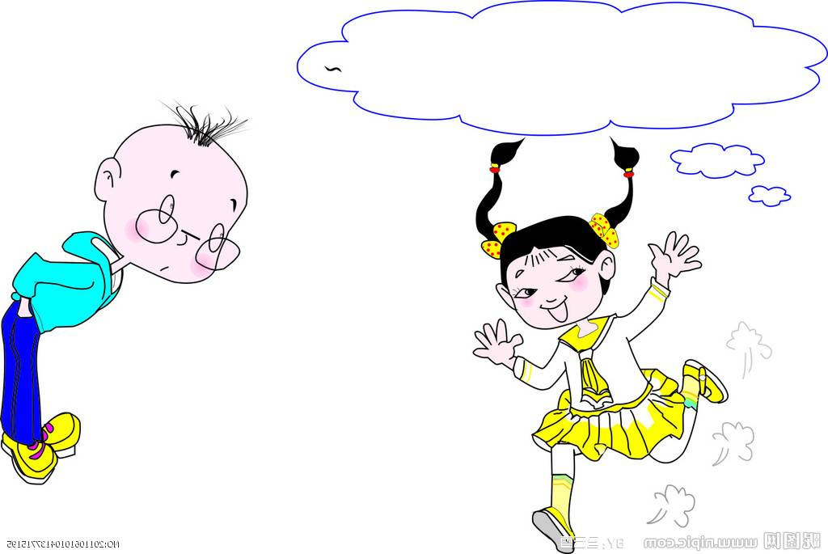
Cindy, what would you like to eat?
I’d like potato salad.

Slide 26
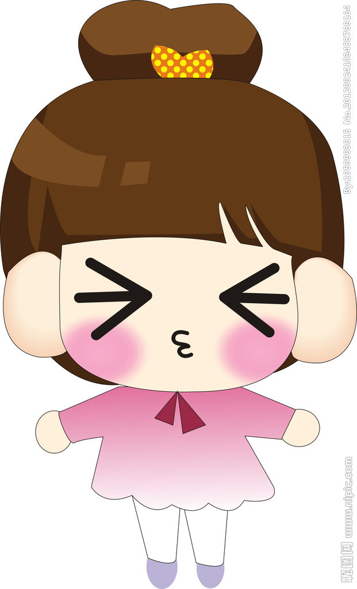
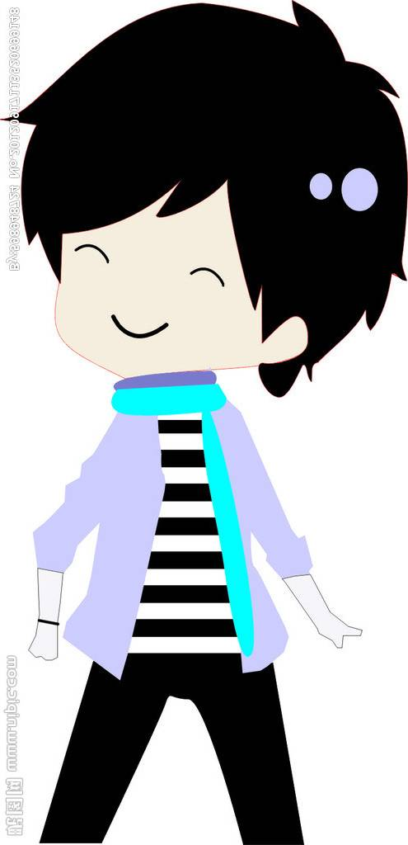
Bob, what would you like to eat?
I’d like a hamburger.

Slide 27
Writing
Bob
Grace
Linda
Anna

Slide 28

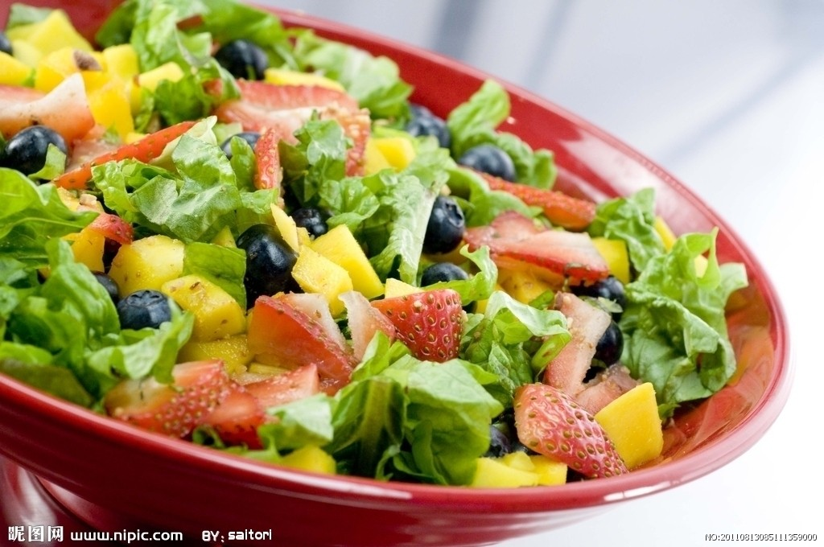
根据图片提示补全对话。
would
— What _______ you like, Jenny?
— I’d like the fruit _____.
What about you?
salad

Slide 29
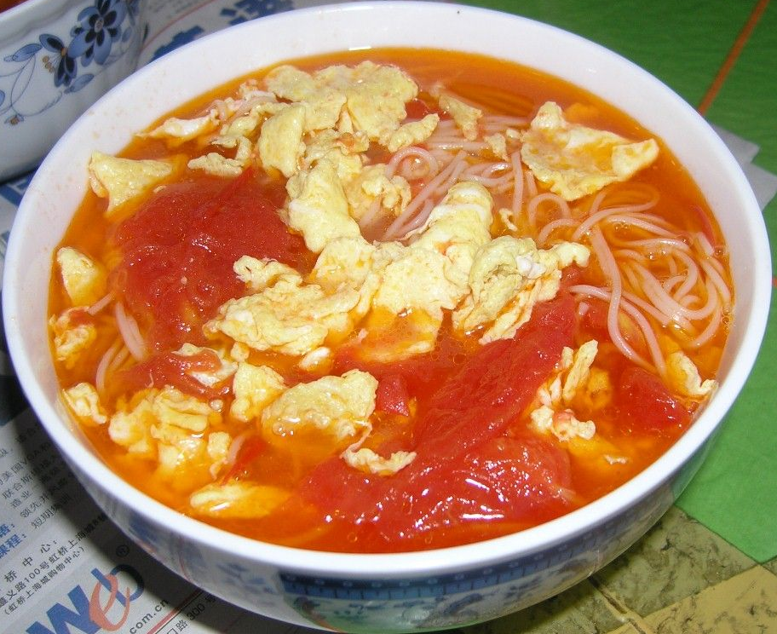
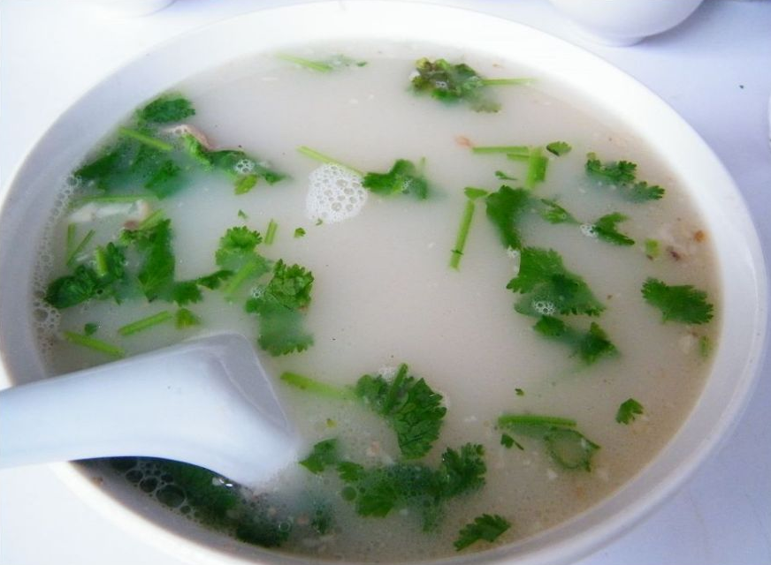
— ___ like the egg and tomato _______.
— Well, what ____ ______ you like?
— I’d like a ______ ____.
— ______ you like some mutton _____?
—No, _______.
I’d
noodles
size would
small one
Would soup
thanks

Slide 30

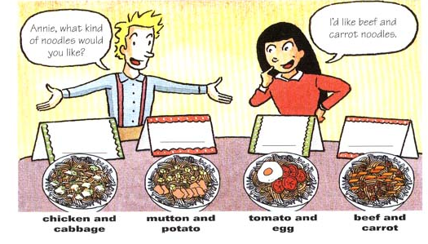
Make a survey
Names | kind of noodles | size bowl of noodles
Give a report like this:
I’d like …
He’d/She’d like…

Slide 31
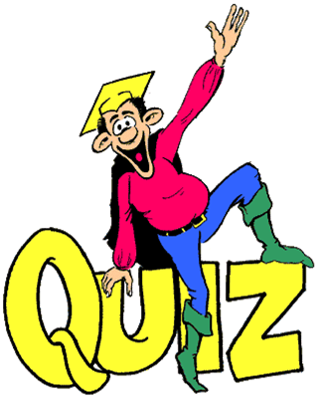

Slide 32
Fill in the blanks.
1. 我想要一些苹果。
I _______ _______ some apples.
2. 汤姆想打网球。
Tom _______ ______ _____ ______
tennis.
3. 我妈妈想让我早点回家。
My mother ______ _____ ___ ___ ___
home early.
would like
would like to play
would like me to go

Slide 33
根据提示词写出恰当的问句或答语完成
对话。
1. A: ______________? (help)
B: Yes, please. I’d like some beef.
2. A: What kind of noodles would you like?
B: _______________________________.
(chicken, cabbage)
3. A: _______________________?
(Paul)
B: He’d like a medium bowl.
Can I help you
I’d like chicken and cabbage noodles
What size would Paul like

Slide 34
4. A: ___________________? (what)
B: I’d like some potatoes.
5. A: ___________________________?
(size)
B: We have large, medium and
small Coke.
What would you like
What sizes of Coke do you have

Slide 35
Translate and write them down.
- 你想要什么面？
- 我想要鸡肉、土豆和胡萝卜面条。
- 你想要多大碗的？
- 我想要一个中碗面。
What kind of noodles would you like?
I’d like chicken, potato and carrot
noodles.
What size would you like?
I’d like a medium bowl, please.

Slide 36

Mutiple choice
1. Would you like ____ hot soup?
A. little B. much C. some D. any
2. –Would you like to come to dinner today?
-I’d like to, ____ I’m too busy.
A. and B. so C. but D. as
3. Mario likes ____ cold hot dogs.
A. eat B. eating
C. ate D. is eating

Slide 37
4. I would like ___ in my noodles.
A. tomatoes and mutton
B. tomatoes and muttons
C. tomato and mutton
D. tomato and muttons
5. They would like ____ noodles.
A. tomatoes and mutton
B. tomatoes and muttons
C. tomato and mutton
D. tomato and muttons

Slide 38
6. —Would you like some _______?
—No, thanks. I’m not hungry at all.
water B. soup
C. orange D. bread
7. — I like reading.
—Me too. I especially like the written by J. K. Rowling.
homework B. numbers
C. movies D. books

Slide 39
8. —What can I do for you?
—Err, I want a glass of milk, some bread and_________.
A. some chickens B. any chickens
C. some chicken
9. —Jenny, What’s your favorite .
—I like bananas best.
A. vegetables B. fruit
C. drink

Slide 40
10. —What kind of porridge would you like, Alice?
---I would like ______.
A. egg porridge B. eggs porridge
C. fish porridges D. fishes porridge
11. ——What would you like to drink, girls?
——________ please.
Two glass of water
B. Two glass of waters
C. Two cups of tea
D. Two cups of teas

Slide 41
Homework
1. Remember the sentences in the
Grammar Focus.
2. Make some conversations to ask your
friends what food they would like. Write
a short conversation.

Slide 42
Thank You!

